Slide 1
Agricultural Applications of Microbes
The use of microorganisms as biofertilizers and biopesticides
Incorporation of microbial genes into crop plants

Slide 2
The use of microorganisms as biofertilizers
Nitrogen and phosphorus are the most limiting nutrients for plant growth and development.
Disadvantage of synthetic fertilizers:
Leads to the deterioration of soil quality, ground and surface water quality
Reduces the biodiversity and suppression of ecosystem function.

Slide 3
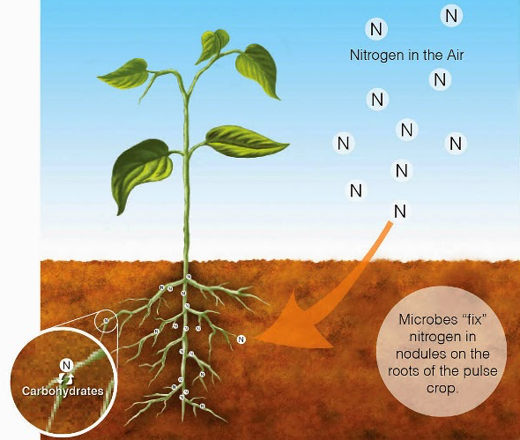
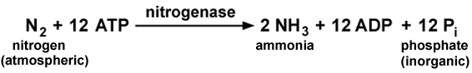
Nitrogen-fixing microorganisms
as biofertilizers
http://balkanecologyproject.blogspot.com/2014/05/nitrogen-fixing-plants.html

Slide 4
Nitrogen-fixing microorganisms
as biofertilizers

Slide 5
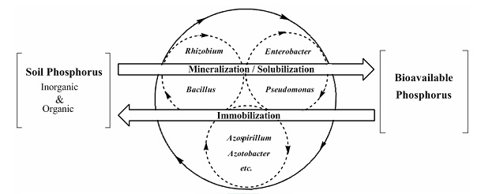
Phosphate solubilizing microorganisms as biofertilizers
http://www.agrinaturals.com/ENfosfo.htm

Slide 6
PGPB (Plant Growth Promoting Bacteria):
plant growth promoters

Slide 7
The use of microorganisms as bio-pesticides
Newly designed pesticides should fulfill the following criteria:
Should not be harmful to the end user
Can be distributed in water
Can be sprayed without difficulty
Takes effect against the pest in crops in lowest possible concentration
Cause as little burden to the environment as possible

Slide 8
The use of microorganisms as biopesticides
Bio-weedicides
Classical Biological Control
Inundated (flood or cover ) or Bioherbicidal Approach

Slide 9
The use of microorganisms as biopesticides
Bio-weedicides
Classical Biological Control
Bioherbicidal Approach
Biofungicides
Control pathogenic fungi by four basic mechanisms:
Direct competition
Antibiosis (antagonism)
Predation or parasitism
Inducing resistance to the host plants.

Slide 10
The use of microorganisms as biopesticides
Bioinsecticides
Insects are susceptible to infection by pathogenic microorganisms (bacteria, fungi, protozoa) and viruses
Entomopathogenic fungi formulated into mycoinsecticides
Bacteria also are found to possess insecticidal properties
Examples:
Bacillus thuringiensis. Bacillus sphaericus, Bacillus subtilis, Bacillus lentimorbus and Bacillus papillae

Slide 11
Bacillus thuringiensis
Microbial pest control agents represent less than 1% of total insecticide sales.
Bacillus thuringiensis accounts for over 90% of the miniscule share of the insecticide market attributable to biological control agents.
Transgenic crop plants that express B. thuringiensis insecticidal proteins have been widely adopted.
In 2002, more than 35 million acres of these transgenic cotton and corn crops were planted worldwide.

Slide 12
B. thuringiensis sporulation
Bechtel and Bulla (1976) Journal of Bacteriology

Slide 13
Bt toxins
Modern industrial microbiology and biotechnology

Slide 14
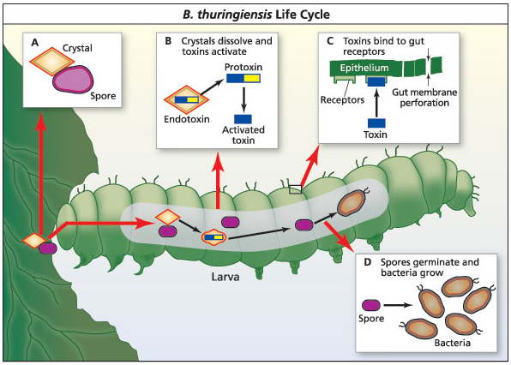

Slide 15
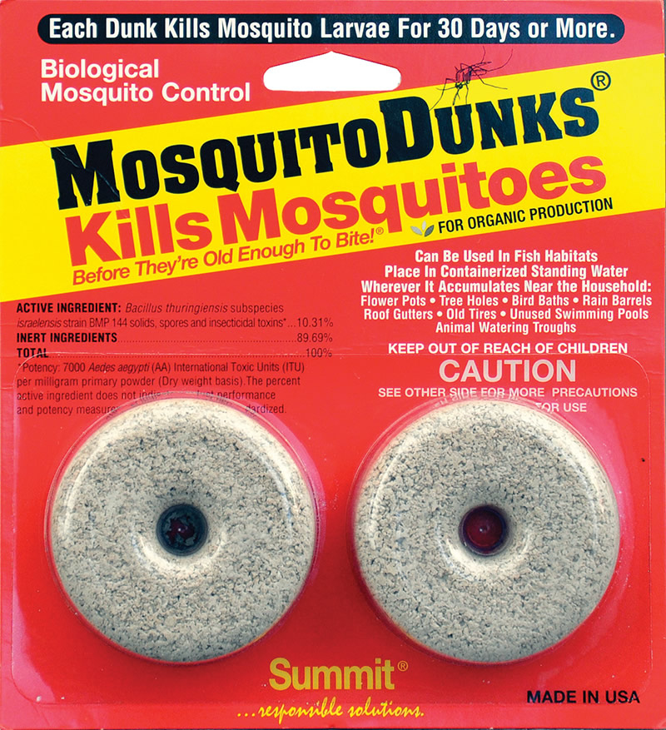

Slide 16
Biorational pesticides of microbial origin
Natural chemicals that function as pesticides but have limited or no adverse effects on the environment and the non-target organisms including humans.
Allelopathy: Biochemical interactions occurring among plants and mediated by microorganisms
Allelochemicals are organic compounds produced by microbes or plants that stimulate or inhibit the neighboring plant or microorganism
Phytotoxins are toxic to plants
Zootoxins have toxicity towards animals and insects
Antibiotics are used against plant pathogens

Slide 17
Allelopathy
Cipollini (2013) J Chem Ecol

Slide 18
Incorporation of microbial genes into crop plants
Total world cropland areas (in million hectares) planted with transgenic stocks. (International Service for the Acquisition of Agri-biotech Applications, www.isaaa.org)

Slide 19
Incorporation of microbial genes into crop plants
Transgenic plants are most commonly generated by exploiting a plasmid vector carried by Agrobacterium tumefaciens
These genes cofer the following:
Ability to grow in harsh environments
Herbicide tolerance
Resistance to insect pests
Control of pathogenic bacteria, fungi, and parasitic nematodes
Resistance to viral diseases

